Slide 1

asic Details of the Team and
Problem Statement
Ministry/Organization Name/Student Innovation: Ministry of Jal Shakti
PS Code: SIH 1291
Problem Statement Title: A mobile app that crowd sources water-
related problems from around a community, open sources data, etc.
and display them on a map.
Team Name: Code-Crafters_SKF
Team Leader Name: Ajay Mondal
Institute Code (AISHE): C-6204
Institute Name: Supreme Knowledge Foundation Group of Institutions
Theme Name: Disaster Management

Slide 2
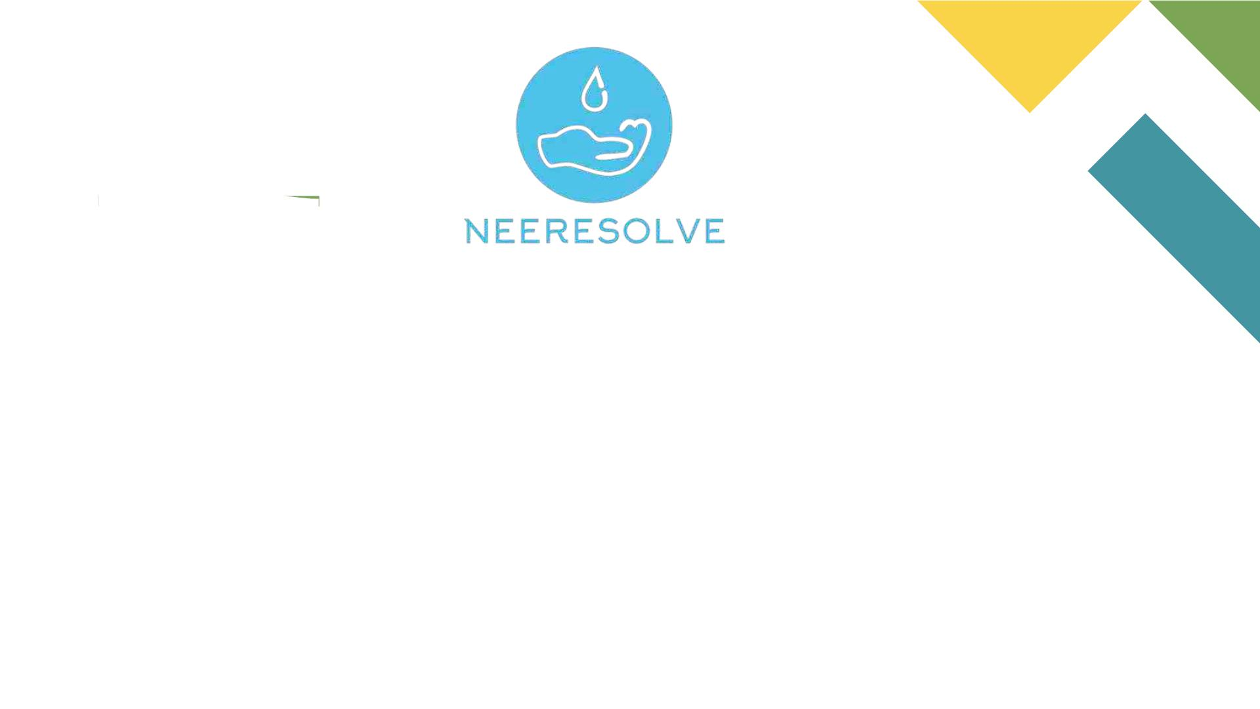
Together we resolve, together we evolve.
Made In India Made For India

Slide 3

Idea Description
Neeresolve: An innovative mobile app designed to address pressing water-related problems in our locality.
Water Vitality: Water, essential for our well-being and the success of our communities, faces challenges like flooding,
water quality concerns, urban flooding, and drainage issues etc.
Collaborative Hub: The app serves as a collaborative hub, collecting geographically tagged images of water-related
problems submitted by citizens.
Awareness and Insights: These visuals not only create awareness for emergency responders but also offer valuable
insights for estimating financial losses.
Smart Technology at Work: Our solution is more than just a map. It's like a super-smart computer that
looks at real pictures taken by people. This high-tech tool automatically checks and sorts out problems with
water, making it easy for everyone to understand.
Cutting-Edge Technology:By focusing on real-life images taken by people, we've utilized cutting-edge technology to
automatically analyze this data.
Categorization and Presentation: The technology categorizes water-related issues and presents them in a user-friendly
way.
Administrative Organization:This mobile app doesn't just categorize issues but also organizes them at
different administrative levels.
Comprehensive Planning: This provides administrators with a comprehensive view, allowing them to plan
and manage these water-related issues wisely.

Slide 4
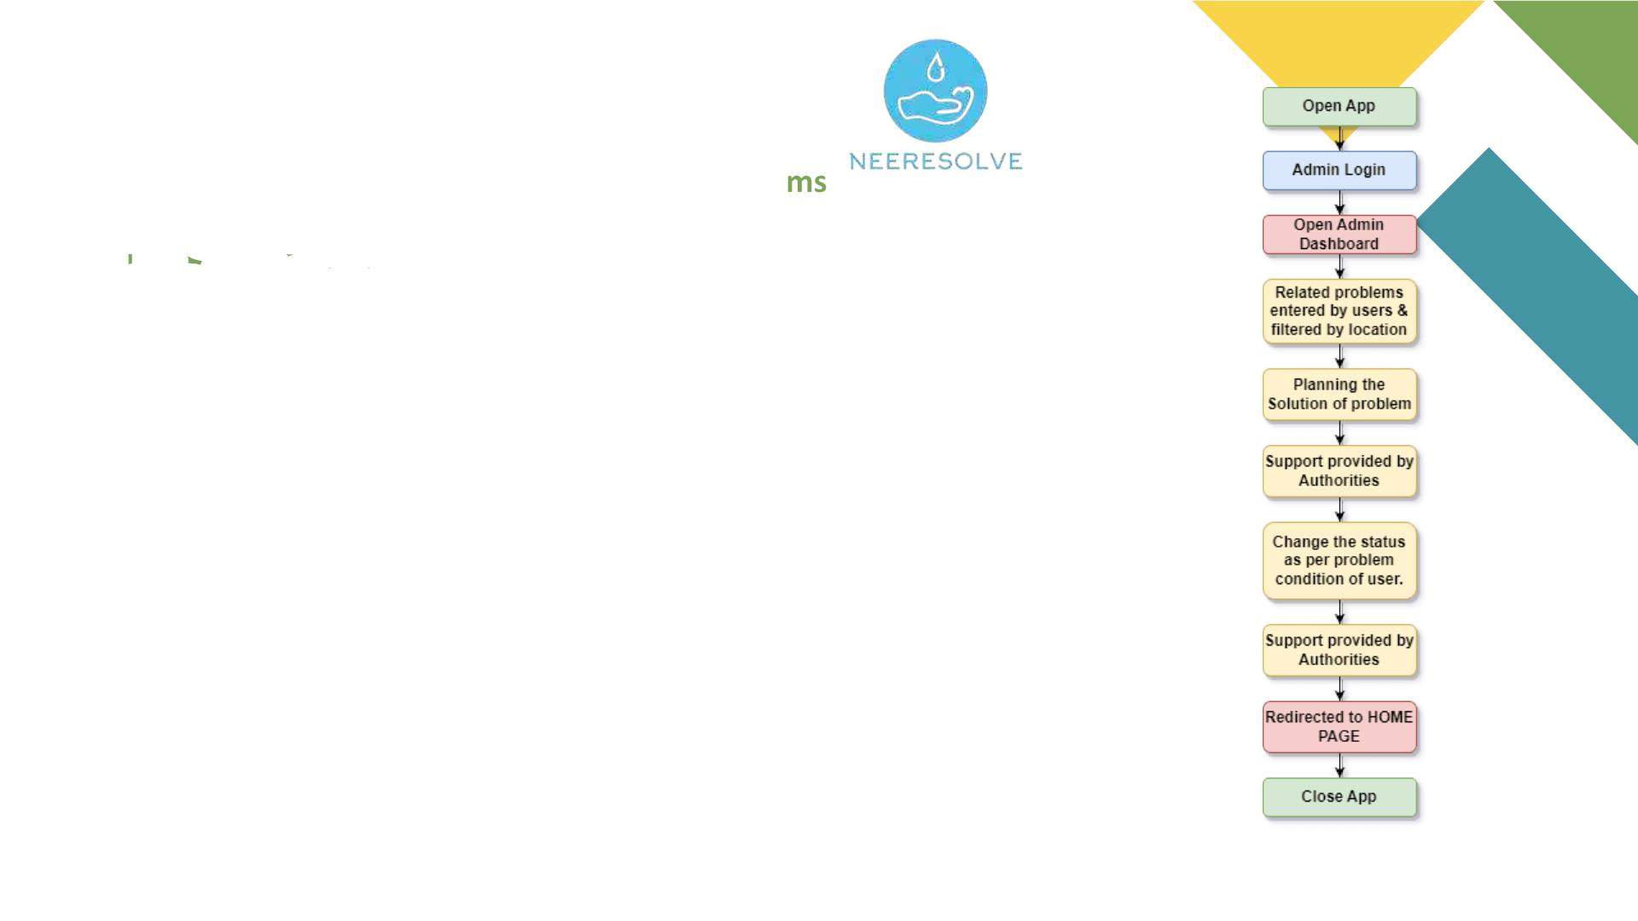
Neeresolve will be solving…
A
d
m
i
Water Logging Problems
Water Pollution Proble
v Urban Waterlogging
v Agricultural
Waterlogging
v Dirty Water from Factories
v Dirty Water from the City
v
Farm Chemicals in Water
v Residential Waterlogging
v Road Waterlogging
v Public Waterlogging
v Trash in the Water
v Water Underground Getting Dirty
n
Water Leakage Problems
v City Water Pipe Leaks
v Factory Water System Leaks
v Farm Water Hose Leaks
v Public Foundation or Park Leaks
v Nature Water Loss
F
l
o
w
v And many more…

Slide 5
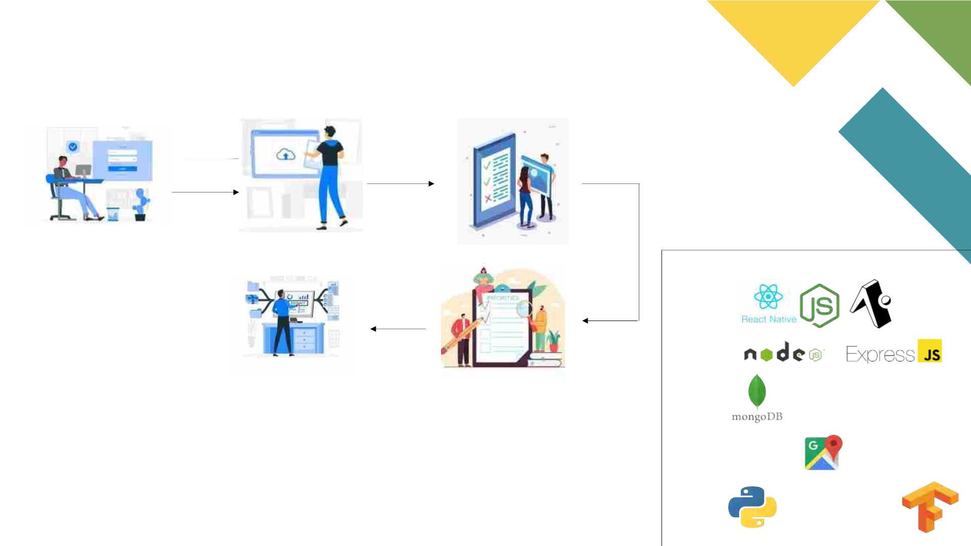
Work Flow of Neeresolve
Login/ Signup
Upload Problems
Validity Check
Technology stack :
Frontend:
Backend:
Database:
Providing Data to Government
Prioritizing Problem
Third Party APIs:
Azure AI Vision
RESNET-50
AI/ML:

Slide 6
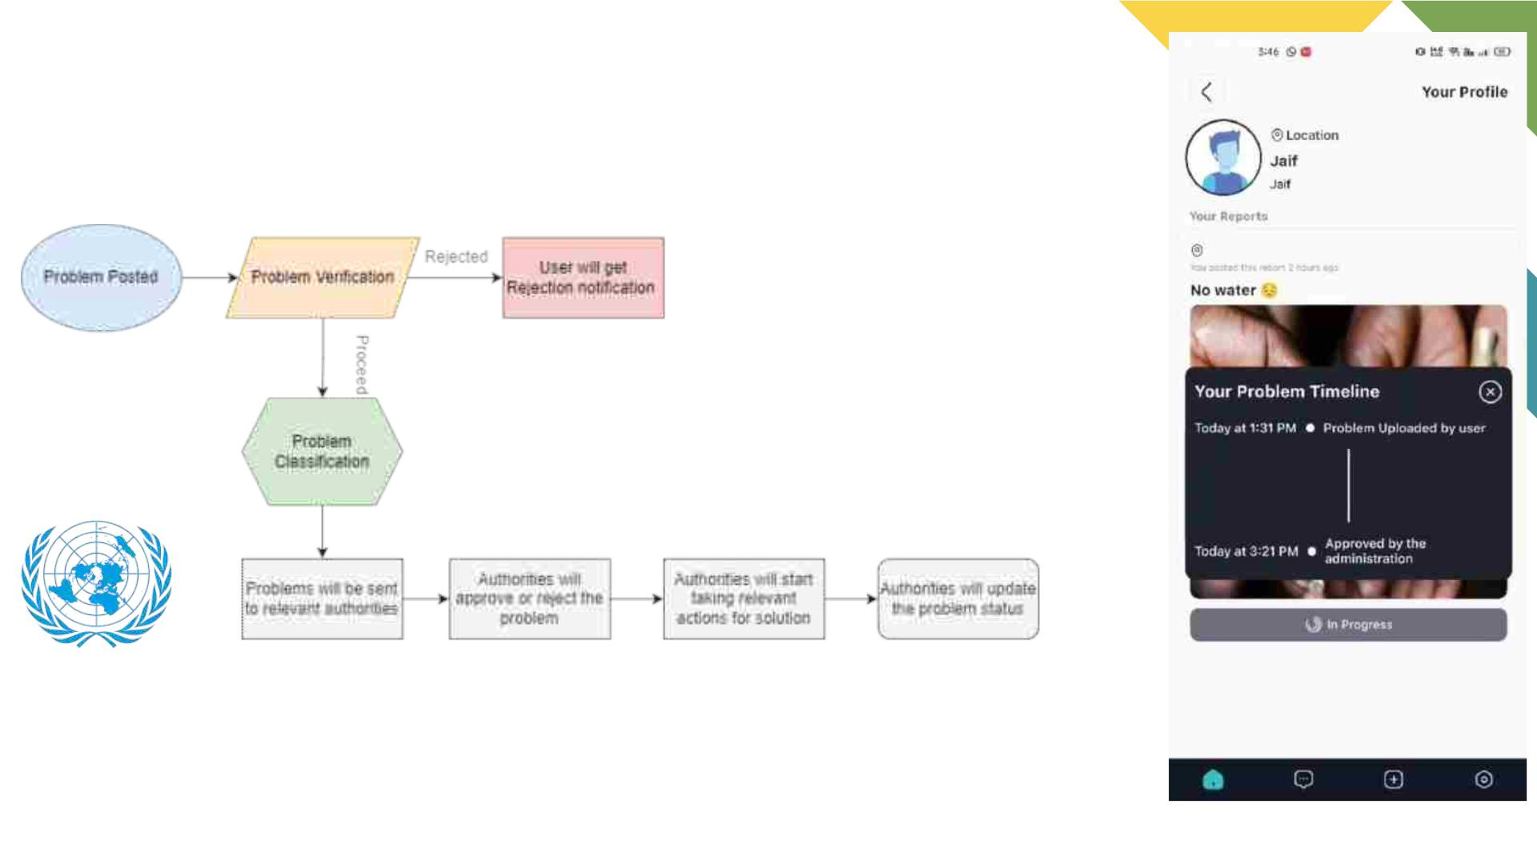
Methodology of capturing and
addressing the Problem
Neeresolve Supports The United Nations Sustainable Goals
The 6th Goal is
Ensure availability and sustainable management of water and sanitation for all

Slide 7

1. Advanced Reporting Features:
a. Multi-media reporting: Allow users to submit photos, and videos (future scope), alongside their reports.
b. Automatic Image Classification through Image Clustering with AI and ML
c. Category and tag selection: Make it easy for users to categorize their reports (e.g., leaks, contamination, access issues) and add relevant tags
for better filtering and analysis.
d. Geospatial accuracy: Implement features like GPS location tagging and geofencing to ensure precise reporting and mapping.
2. Collaborative Problem Solving:
a. Interactive map: Display reported issues on a map with clear visual indicators and allow users to zoom in, filter, and search by location and
category..
b. Community discussion: Integrate forums, comment sections, or chat features for users to discuss reported issues, share solutions, and
collaborate on solutions.
c. Upvote & Downvote system: Login users can upvote and downvote the posts but guest user can’t.
d. Suggestions: Guest users can give suggestions but their suggestions can't be upvoted or downvoted.
e. Direct communication: Allow users to directly contact relevant authorities or stakeholders through the app for faster resolution.
3. Gamification and Incentives:
a. Points and rewards: Implement a points system for reporting issues, participating in discussions, and resolving problems. Offer rewards like
badges, discounts, or donations to incentivize participation. These Reward will provide users with some Financial Benefits.
b. Leaderboards: Create leaderboards showcasing the most active users and communities, encouraging healthy competition and engagement.
c. Challenges and contests: Organize challenges or contests related to water conservation, reporting specific issues, or achieving certain goals to
promote action.

Slide 8

4. Data Analysis and Visualization:
a. Data dashboards: Provide interactive dashboards displaying aggregated data on reported issues, trends, and progress towards
resolutions.
b. Problem status Tracker:Problem Status will be updated as per the progress of the solution of the problem.
c. Heat maps and interactive charts: Utilize visual representations to identify hotspots, analyze trends, and inform decision-making.
d. Predictive analytics: AI and data analysis will be applied to predict potential water-related problems.
5. Open Source Data and Transparency:
a. Public data access: Reported data publicly accessible through open APIs and data visualization tools, promoting transparency and
stakeholder engagement.
b. Collaboration with NGOs and authorities: Partner with NGOs, government agencies, and water utilities to share data, facilitate
resolution of reported issues, and improve water management.
6. Additional Features:
a. Multilingual support: Cater to diverse communities by offering the app in multiple languages.
b. Accessibility features: Ensure the app is accessible to users with disabilities by incorporating text-to-speech, screen readers, and
other assistive technologies.
7. Anti Spoofing: After uploading the problem we will use anti spoofing technique. If it will be copied from any other other social media
image sources then it will be shown as invalid data at the admin side.
Cosine Similarity Factor Formula for Image Clustering:

Slide 9
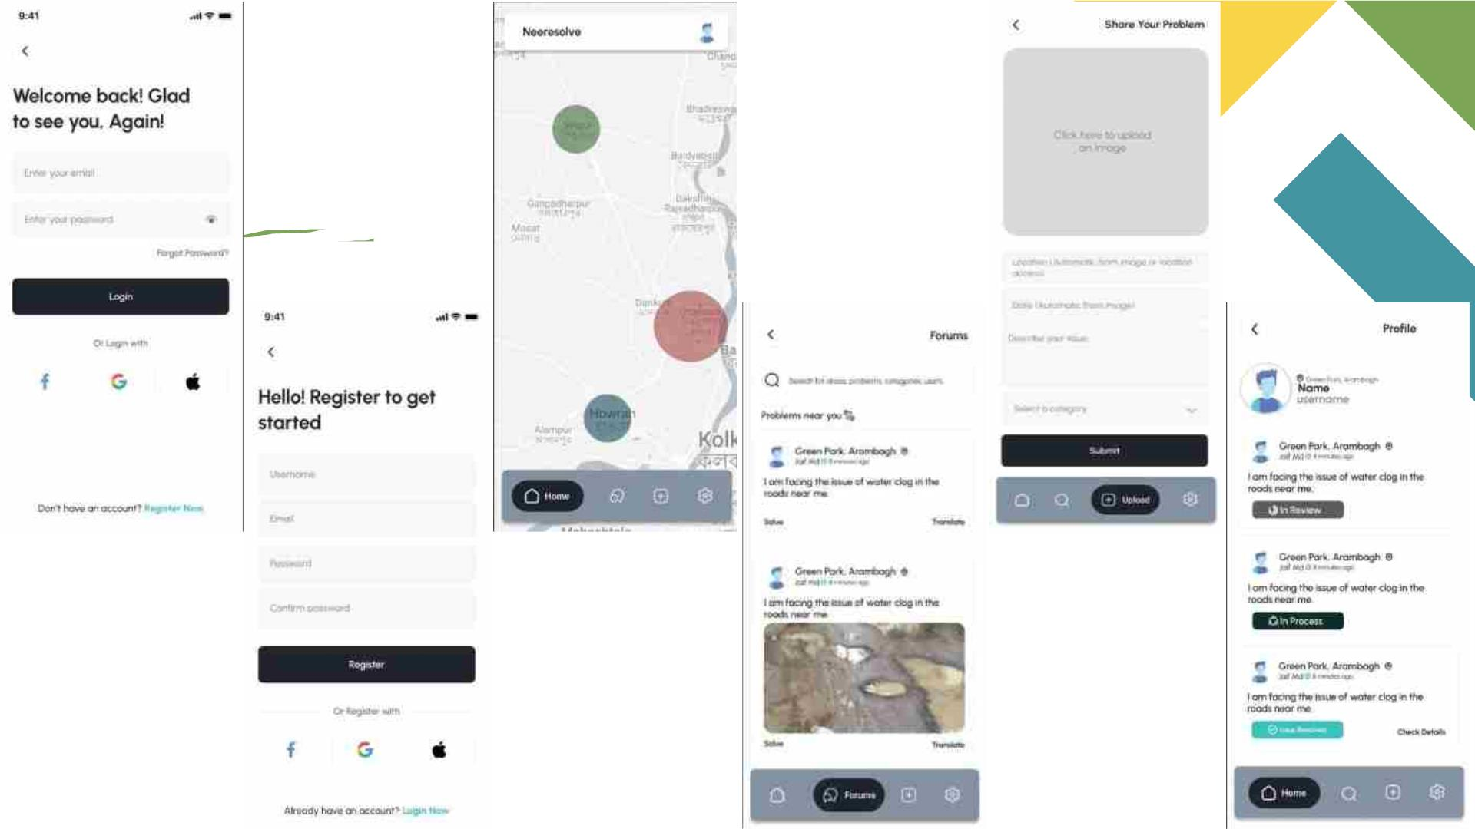

Slide 10

Future Scopes:
1. Expansion of Data Types:Incorporate additional data types, such as water quality metrics, pollution levels, and seasonal variations, to provide
a comprehensive overview.
2. Machine Learning for Predictive Analysis: Implement machine learning algorithms to analyse historical data and predict potential water-
related issues, aiding in proactive decision-making.
3. User Engagement Features: Enhance user engagement with features like gamification, challenges, and incentives to encourage consistent
data contributions.
4. Mobile App Enhancements: Continuously improve the mobile app interface, usability, and features based on user feedback to ensure a
seamless experience.
5. Partnerships with Research Institutions: Collaborate with research institutions to leverage the collected data for scientific studies, furthering
understanding of local water ecosystems.
6. Community Awareness Initiatives: Implement features that educate and raise awareness about water conservation, fostering a sense of
responsibility within the community.
7. Accessibility and Inclusivity: Ensure accessibility for diverse communities, possibly by incorporating multilingual support and features that
cater to different demographics.
8. Blockchain for Data Security: Explore blockchain technology to enhance data security and transparency, building trust among users and
authorities.
9. Emergency Response Integration: Collaborate with emergency response services to integrate the platform into their systems, facilitating quick
responses to water-related emergencies.

Slide 11
Together we resolve, together we evolve.
Made In India Made For India
THANK YOU
Your Questions & valuable
suggestions?

Slide 12
Team Member Details:
Team Leader Name: Ajay Mondal
Branch (Btech/Mtech/PhD etc): B.Tech
Team Member 1 Name: Sneha Deb
Branch (Btech/Mtech/PhD etc): B.Tech
Team Member 2 Name: Fardeen Ansari
Branch (Btech/Mtech/PhD etc): B.Tech
Team Member 3 Name: Swarnab Saha
Branch (Btech/Mtech/PhD etc): B.Tech
Team Member 4 Name: Aneek Hazra
Branch (Btech/Mtech/PhD etc): B.Tech
Team Member 5 Name: Subid Das
Branch (Btech/Mtech/PhD etc): B.Tech
Team Mentor 1 Name: Prof. Saurav Nag
Category (Academic/Industry): Academic
Stream (ECE, CSE etc): CSE
Stream (ECE, CSE etc): CSE
Stream (ECE, CSE etc): CSE
Stream (ECE, CSE etc): CSE
Stream (ECE, CSE etc): CSE
Stream (ECE, CSE etc): CSE
Year (I,II,III,IV): II
Year (I,II,III,IV): II
Year (I,II,III,IV): II
Year (I,II,III,IV): II
Year (I,II,III,IV): II
Year (I,II,III,IV): I
Expertise: Android Development
Domain Experience: Computer Science Professor
Team Mentor 2 Name: Prof. Dr. Dhrubasish Sarkar
Category (Academic/Industry):Academic
Expertise: Computational Social Sciences, AI/ML, SNA
Domain Experience: Computations & Engineering

